Slide 1



PNW Spring 2026 CS 51510-002 Algorithms | Course Project 3

Slide 2
US Highway Graph Routing
Implementing Graph Algorithms for Modern Travel Optimization in Central and Eastern United States
Panagiotis Papadopoulos
Jeevana Shruti Kunuku
Ghaayathri Devi Kannan
Roshini Tamanamu
Pavan Praneeth Katakam
Veda Pranay
MedasaniSurya Teja Kolli
PNW Spring 2026 CS 51510-002 Algorithms | Course Project 3

Slide 3


Advising Professor
Wei David Dai, Ph.D.
Assistant Professor of Computer Science
Director of Advanced Intelligence Software Lab
PNW Spring 2026 CS 51510-002 Algorithms | Course Project 3
Notes:
Before we dive into the technical architecture, we must acknowledge the guidance of our advising professor, Dr. Wei David Dai.
Dr. Dai’s approach changed how we viewed this project. He didnt just teach us the algorithms, He pushed us to stop thinking as just 'coders' and start thinking as 'engineers.'
Through his mentorship, he didn't just teach us the Huffman or B+ Tree algorithms; he challenged us to analyze this' problem through four distinct, high-level pillars.
The Business Angle: "We analyzed the cost of development time versus execution speed. While Python allows for rapid prototyping, which is a business win for 'time-to-market,' we had to weigh that against the long-term compute costs of a language like Julia."
The Theoretical Angle: "This is where the math meets the metal. We balanced the absolute mathematical compression of Shannon Entropy in Huffman Coding against the structural predictability and search-heavy speed of B+ Trees."
The Hardware Angle: "Running this on an environment that run Ubuntu 22.04 LTS allowed us to see how the silicon actually responds. We monitored CPU spikes and memory faults, noticing that Julia’s JIT overhead can hit 81% CPU utilization, which has massive implications for hardware scaling."
The Maintenance Angle: "A database is only as good as its longevity. We focused on modularity—separating our primary storage in a Doubly Linked List from our indexing layers—so that in a real production environment, an engineer could update an algorithm without rebuilding the entire data core."

Slide 4
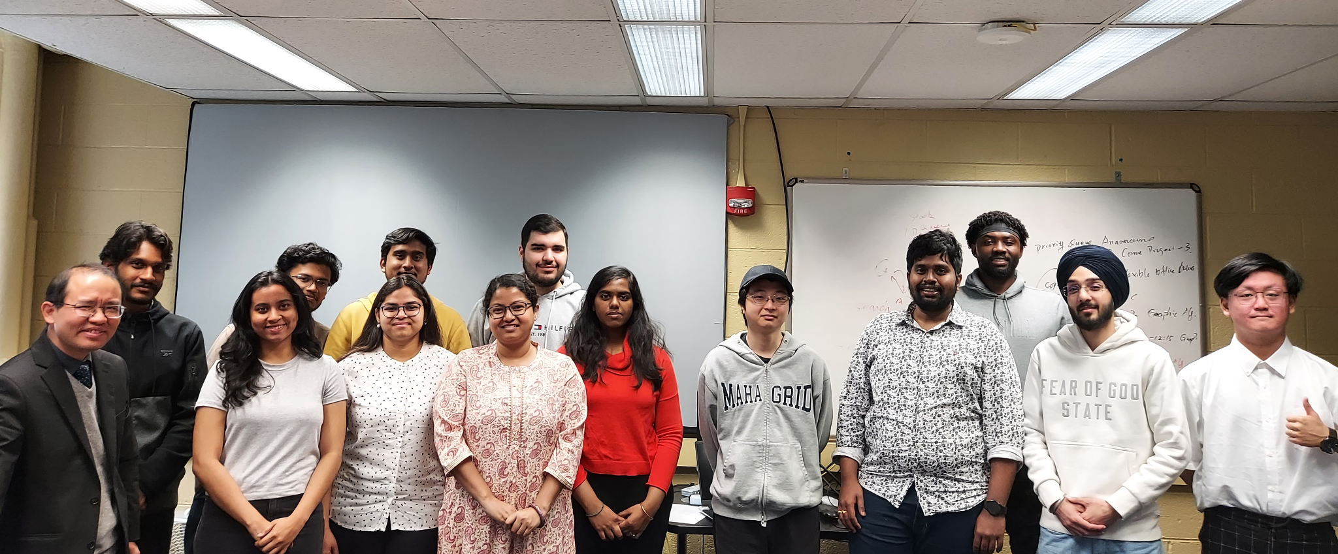
Algorithms Class CS 51510-002
PNW Spring 2026 CS 51510-002 Algorithms | Course Project 3
Notes:
Before we dive into the technical architecture, we must acknowledge the guidance of our advising professor, Dr. Wei David Dai.
Dr. Dai’s approach changed how we viewed this project. He didnt just teach us the algorithms, He pushed us to stop thinking as just 'coders' and start thinking as 'engineers.'
Through his mentorship, he didn't just teach us the Huffman or B+ Tree algorithms; he challenged us to analyze this' problem through four distinct, high-level pillars.
The Business Angle: "We analyzed the cost of development time versus execution speed. While Python allows for rapid prototyping, which is a business win for 'time-to-market,' we had to weigh that against the long-term compute costs of a language like Julia."
The Theoretical Angle: "This is where the math meets the metal. We balanced the absolute mathematical compression of Shannon Entropy in Huffman Coding against the structural predictability and search-heavy speed of B+ Trees."
The Hardware Angle: "Running this on an environment that run Ubuntu 22.04 LTS allowed us to see how the silicon actually responds. We monitored CPU spikes and memory faults, noticing that Julia’s JIT overhead can hit 81% CPU utilization, which has massive implications for hardware scaling."
The Maintenance Angle: "A database is only as good as its longevity. We focused on modularity—separating our primary storage in a Doubly Linked List from our indexing layers—so that in a real production environment, an engineer could update an algorithm without rebuilding the entire data core."

Slide 5
Project Overview
account_tree
Foundation
Data modeling, graph construction rules, and Central/Eastern dataset overview.
memory
Algorithms
Traversals (BFS/DFS)
MST (Prim/Kruskal)
Shortest Paths (Dijkstra/Bellman-Ford).
terminal
Live Demo
Python implementation walkthrough and real-time highway metric simulation.
PNW Spring 2026 CS 51510-002 Algorithms | Course Project 3

Slide 6
Project Motivation
Why Graph Theory for Highway Routing?
Solving the complex problem of travel routing by combining classical algorithms with real-world constraints like weather, elevation, and fuel efficiency.
route Complex Travel Routing
settings_suggest Classical Algorithm Integration
filter_hdr Real-world Constraints (Weather, Elevation, Fuel)
PNW Spring 2026 CS 51510-002 Algorithms | Course Project 3

Slide 7
Dataset & Problem Constraints
Nodes & Regions
Operational Limits
38 cities representing Central/Eastern time zones.
One city for every state plus Washington, DC.
Nodes include Lat/Lon and elevation data.
Driving Limit: 8 hours/day at 75 MPH.
Vehicle Efficiency: 45 MPG baseline.
Window: Jan 1 to Mar 30, 2026.
PNW Spring 2026 CS 51510-002 Algorithms | Course Project 3

Slide 8
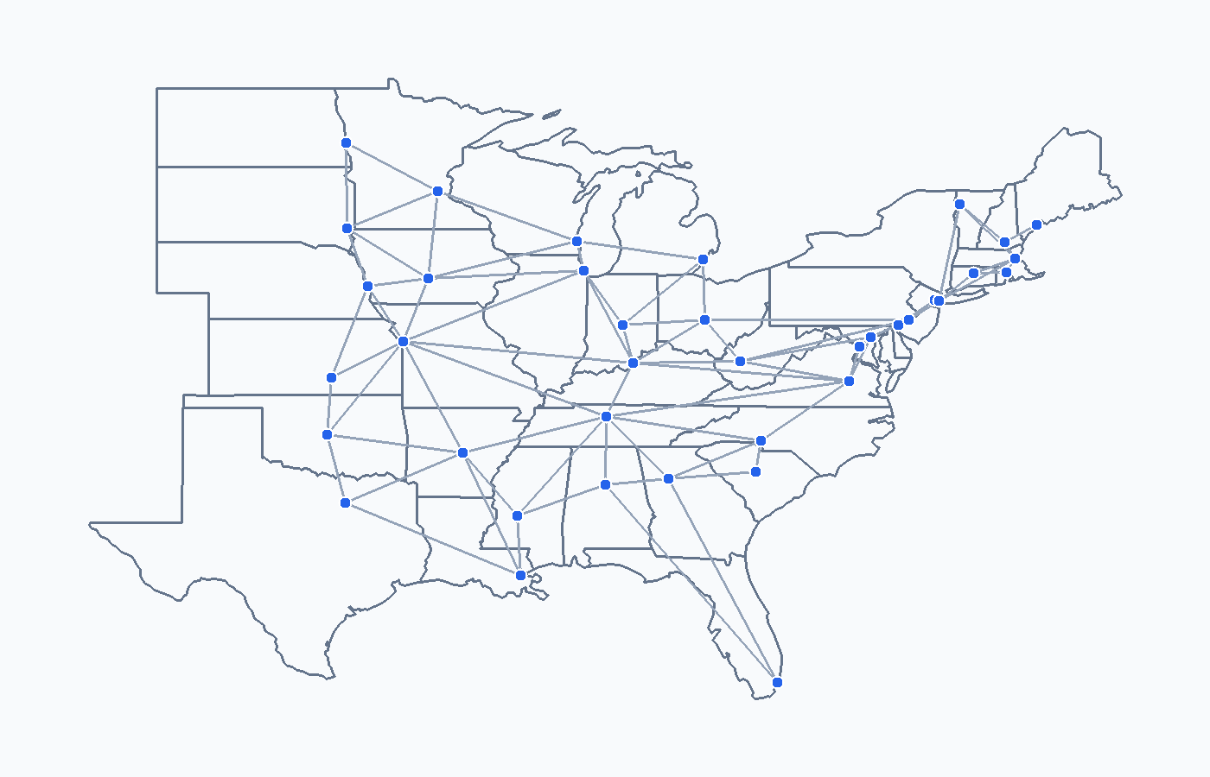
Graph Construction Rule
Neighboring State Logic
Edges are created only between cities whose states share a physical border. This forces realistic highway movement patterns rather than simple straight-line connectivity.
insights Undirected, weighted graph
straighten Weights = estimated highway mileage
hub 38 nodes | ~100 unique edges
PNW Spring 2026 CS 51510-002 Algorithms | Course Project 3

Slide 9
Graph Construction Rule
Neighboring State Logic
Edges are created only between cities whose states share a physical border. This forces realistic highway movement patterns rather than simple straight-line connectivity.
insights Undirected, weighted graph
straighten Weights = estimated highway mileage
hub 38 nodes | ~100 unique edges
PNW Spring 2026 CS 51510-002 Algorithms | Course Project 3

Slide 10
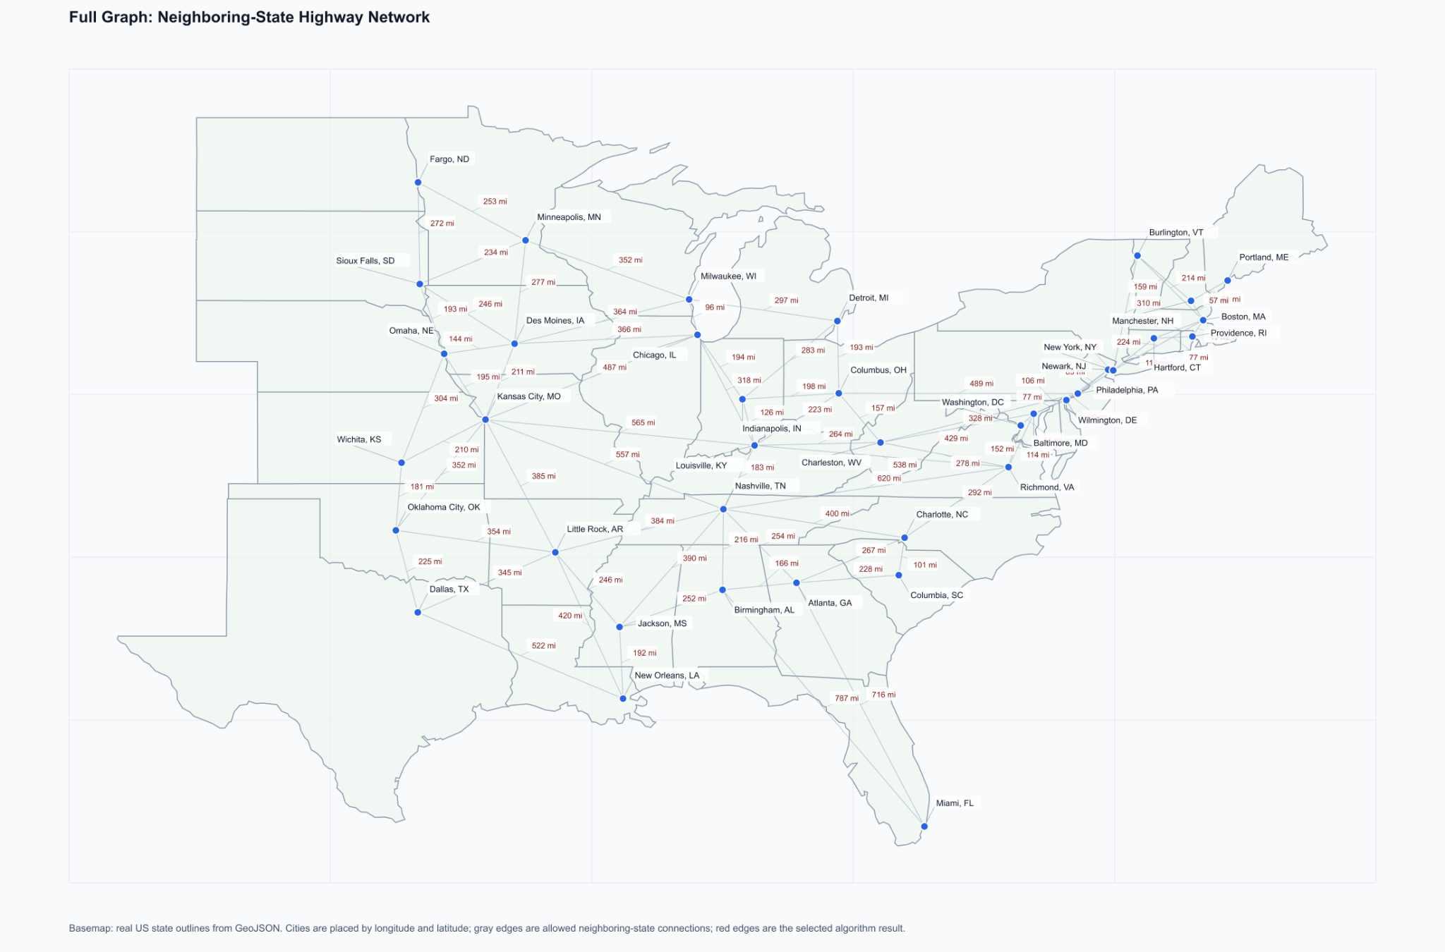
Full Graph on Map
Technical Specs
Basemap
Real US state outlines generated from GeoJSON source files.
City Placement
Nodes are precisely positioned using exact longitude and latitude coordinates.
Edge Logic
Gray lines represent allowed neighboring-state highway connections.
PNW Spring 2026 CS 51510-002 Algorithms | Course Project 3

Slide 11
Traversals: BFS vs DFS
account_tree
Breadth-First Search
Explores the network level-by-level from the origin. Best for determining reachability and minimum edge count paths.
explore
Depth-First Search
Follows branches deeply before backtracking. Excellent for structural exploration and cycle detection within the highway network.
Note: Both visit the same connected components, but orders differ significantly.
PNW Spring 2026 CS 51510-002 Algorithms | Course Project 3

Slide 12
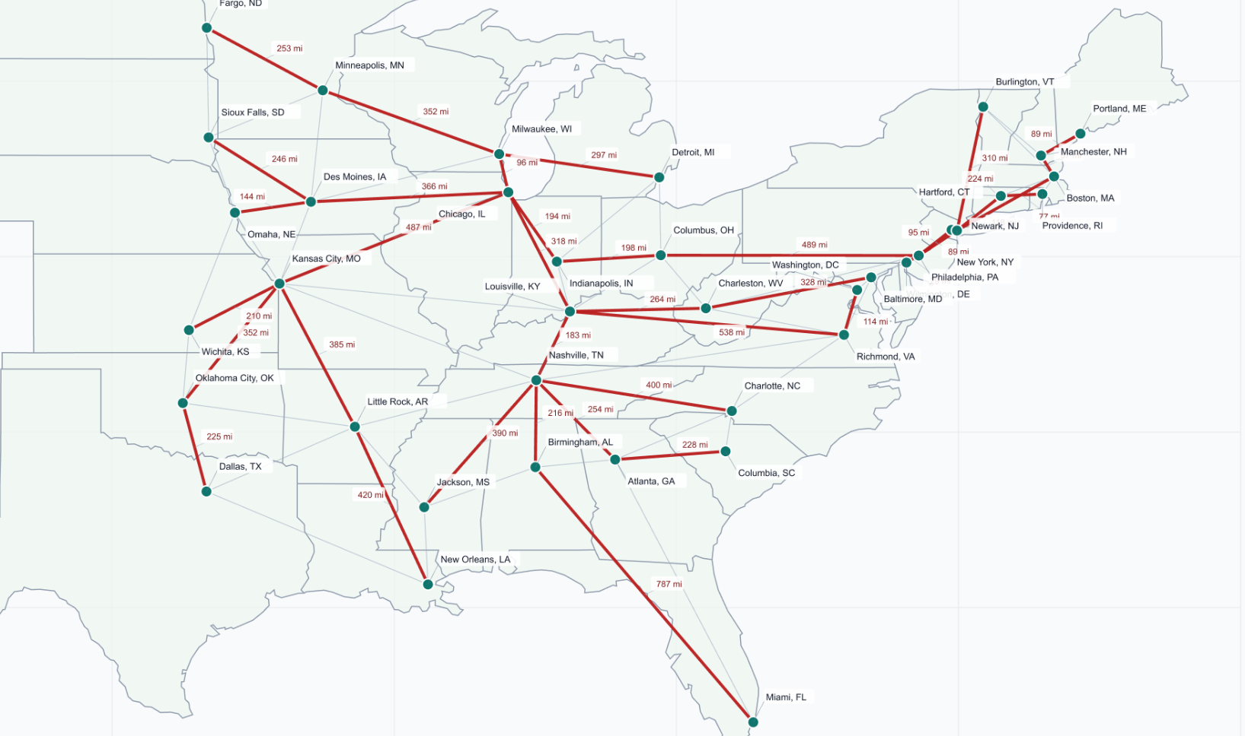
BFS Traversal: Starting from Chicago
Traversal Logic
Level-by-Level Discovery
The red lines illustrate the BFS search frontier expanding outward from the Chicago hub.
Key Observations
Finds the shortest path in terms of number of edges.
Exhausts all neighbors at distance 1 before moving to distance 2.
Ideal for analyzing connectivity in regional highway clusters.
PNW Spring 2026 CS 51510-002 Algorithms | Course Project 3

Slide 13
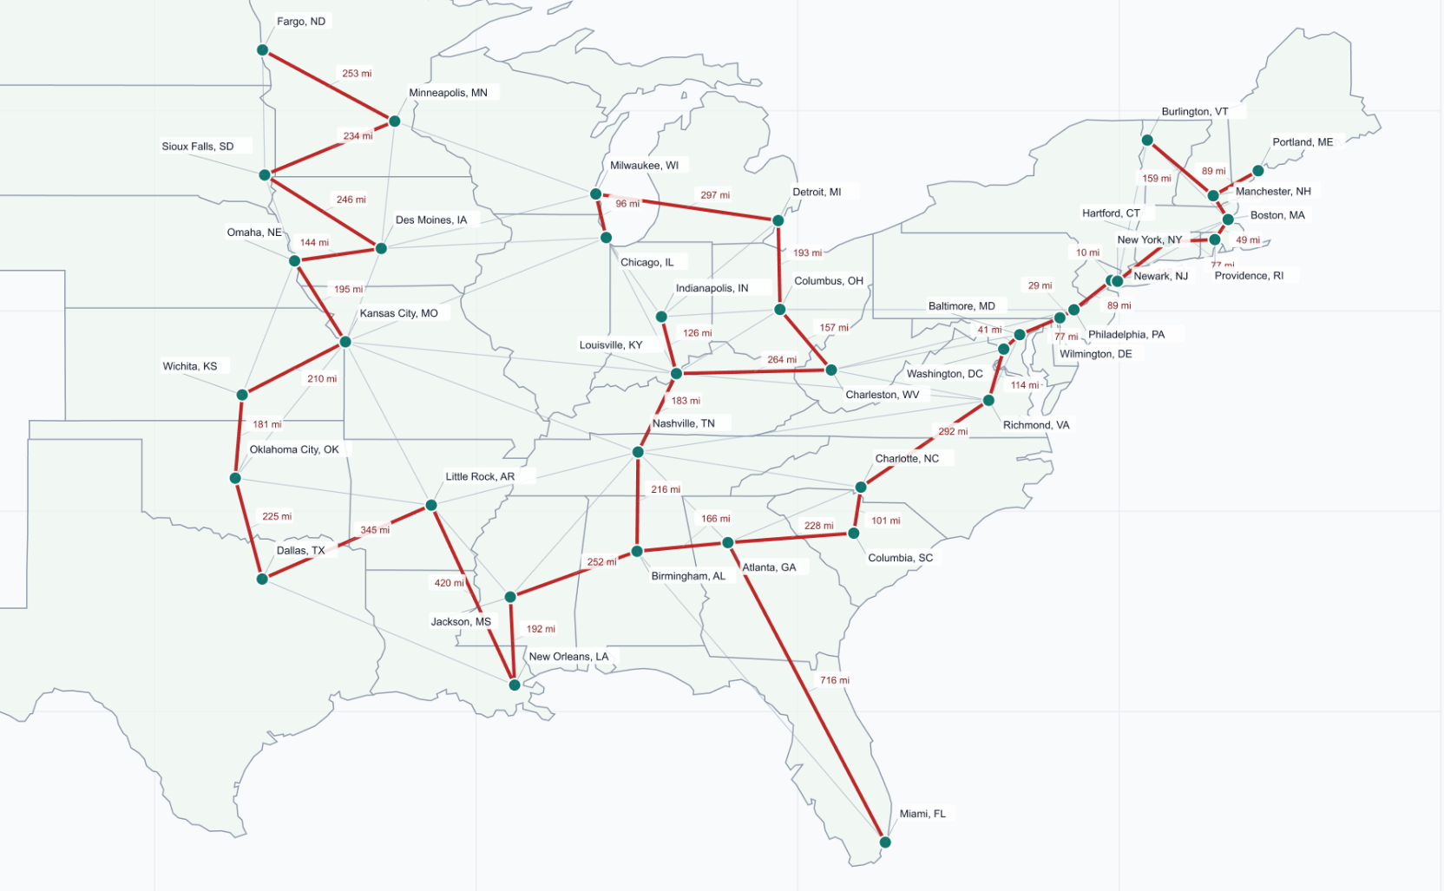
DFS Traversal: Starting from Chicago
Traversal Logic
Path Exploration
The DFS algorithm follows a single path to its terminal end before backtracking to the last unvisited branch.
Key Characteristics
Prioritizes depth over breadth in search pattern.
Utilizes a stack-based approach (often via recursion).
Ideal for topological sorting and cycle detection.
Red lines trace the unique structural path discovered.
PNW Spring 2026 CS 51510-002 Algorithms | Course Project 3

Slide 14
Minimum Spanning Trees
account_tree
Prim's Algorithm
Grows the tree outward from a single starting node, greedily adding the cheapest accessible edge.
hub
Kruskal's Algorithm
Sorts all edges globally and adds them if they don't create a cycle, creating a forest that merges.
verified
Validation
Both algorithms yield the exact same MST total distance, confirming optimization integrity.
PNW Spring 2026 CS 51510-002 Algorithms | Course Project 3

Slide 15
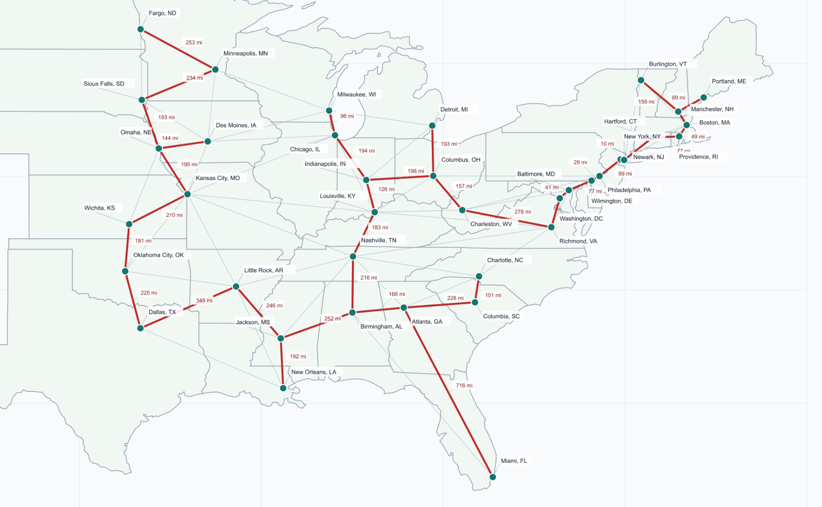
Prim's Minimum Spanning Tree
MST Highlights
Greedy Growth
Expands from a single node by selecting the least expensive edge connecting to the tree.
Network Coverage
Connects all major US hubs.
Minimizes total road mileage.
Eliminates redundant cycles.
PNW Spring 2026 CS 51510-002 Algorithms | Course Project 3

Slide 16

Kruskal's Minimum Spanning Tree
MST Logic
Global Optimization
Processes all edges across the entire graph simultaneously by weight, rather than expanding from one node.
Key Mechanics
Edges sorted by ascending weight.
Cycle prevention via Disjoint Set.
Merges disjoint components into one.
PNW Spring 2026 CS 51510-002 Algorithms | Course Project 3

Slide 17
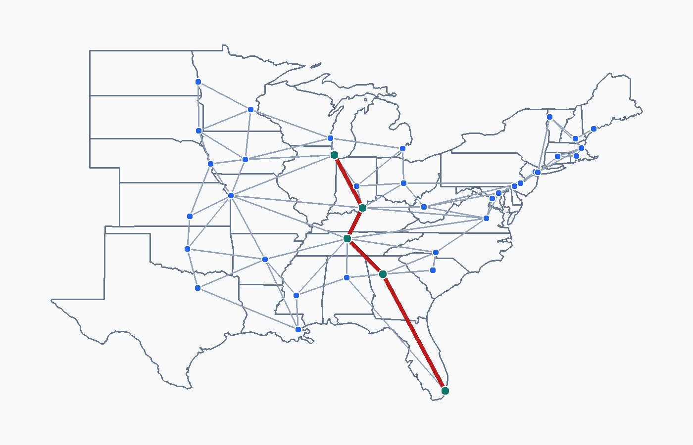
Shortest Path Algorithms
Dijkstra vs Bellman-Ford
Dijkstra is our primary engine for point-to-point routing due to its efficiency on positive-weight highway edges.
Dijkstra
Optimized via heap queue (O(E log V)).
Bellman-Ford
Robust verification tool; supports negative edges.
Metrics
Miles, Risk, and Fuel output.
PNW Spring 2026 CS 51510-002 Algorithms | Course Project 3

Slide 18
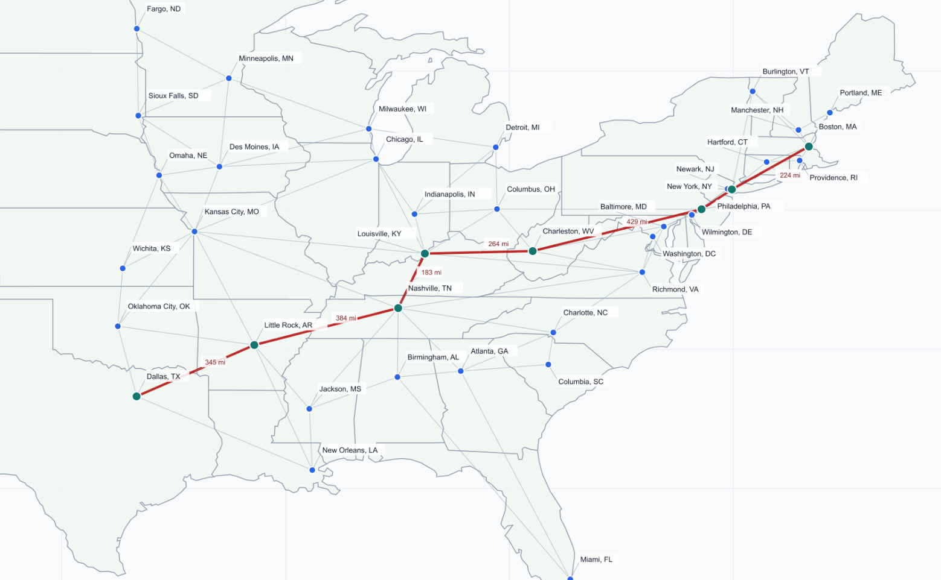
Dijkstra Path: Dallas to Boston
Path Attributes
Algorithm: Dijkstra
Route: Dallas (TX) to Boston (MA)
Efficiency: High; greedy approach optimized with a priority queue for rapid point-to-point pathfinding.
Execution: 0.32 ms
Complexity: O(E log V)
PNW Spring 2026 CS 51510-002 Algorithms | Course Project 3

Slide 19
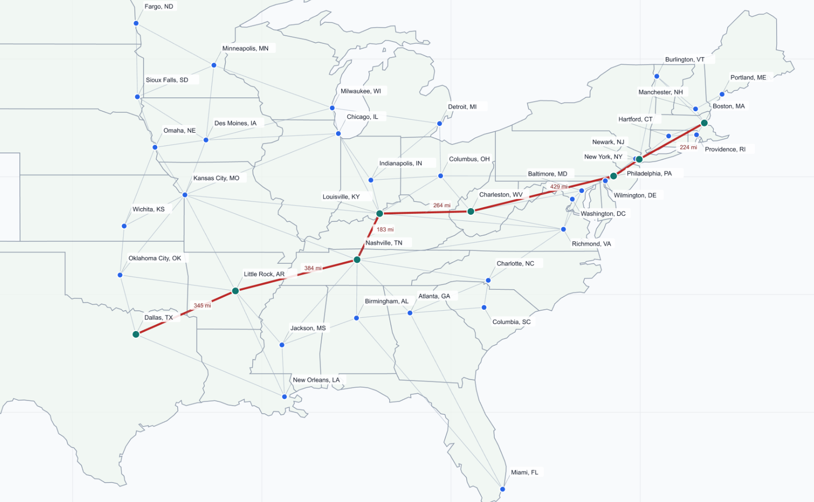
Bellman-Ford Path: Dallas to Boston
Path Attributes
Algorithm: Bellman-Ford
Route: Dallas (TX) to Boston (MA)
Reliability: High; exhaustively verifies the shortest path and handles potential negative edge weights.
Execution: Slower than Dijkstra (1.15 ms vs 0.32 ms) but essential for risk-weighted verification in complex networks.
PNW Spring 2026 CS 51510-002 Algorithms | Course Project 3

Slide 20
Physics & Environmental Logic
terrain
1 + tan(θ)
ELEVATION FACTOR
Real distance adjustment based on vertical climb.
local_gas_station
45
MPG EFFICIENCY
Calculated fuel consumption for heavy transport.
ac_unit
10x
WEATHER PENALTY
Snow/Ice risk weight compared to clear skies.
PNW Spring 2026 CS 51510-002 Algorithms | Course Project 3

Slide 21
Travel Plan: Dallas → Boston
Route Summary
Route: Dallas → Little Rock → Nashville →
Louisville → Charleston → Philadelphia →
New York → Boston
Map distance: 1,924.2 miles
Elevation-adjusted dist.: 1,924.2 miles
Travel days: 4 (max 8 hrs/day)
Total hours on road: 25.66 hrs
Gasoline consumed: 42.76 gal (45 mpg)
Best start date: 2026-02-08
Weather risk: 11.0 (1.57/leg avg)
Leg-by-Leg Breakdown (7 legs)
1. Dallas → Little Rock 345.1 mi
2. Little Rock → Nashville 383.6 mi
3. Nashville → Louisville 182.9 mi
4. Louisville → Charleston 264.1 mi
5. Charleston → Philadelphia 429.1 mi
6. Philadelphia → New York 95.0 mi
7. New York → Boston 224.4 mi
PNW Spring 2026 CS 51510-002 Algorithms | Course Project 3

Slide 22
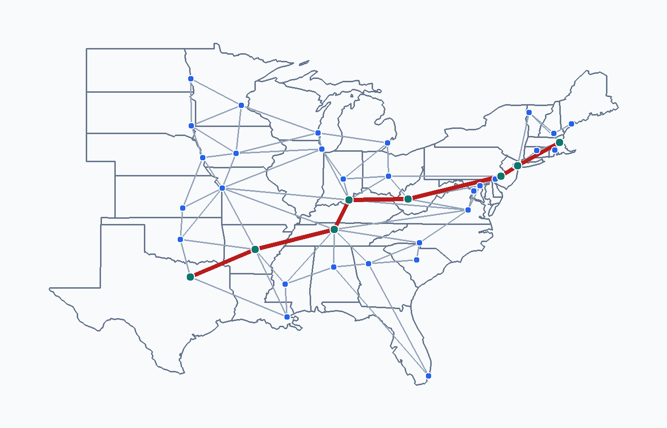
Travel Plan: Day-by-Day Itinerary
Day-by-Day Itinerary (starting 2026-02-08)
Day 1 (2026-02-08) — 600 mi, 8.0 hrs
Dallas → Little Rock (cloud/cloud)
Little Rock → Nashville (cloud/sun)
Day 2 (2026-02-09) — 600 mi, 8.0 hrs
Little Rock → Nashville (sun/rain)
Nashville → Louisville (rain/sun)
Louisville → Charleston (sun/sun)
Charleston → Philadelphia (sun/cloud)
Day 3 (2026-02-10) — 600 mi, 8.0 hrs
Charleston → Philadelphia (rain/sun)
Philadelphia → New York (sun/sun)
New York → Boston (sun/rain)
Day 4 (2026-02-11) — 124.2 mi, 1.7 hrs
New York → Boston (cloud/snow)
Dijkstra shortest route map: Dallas to Boston
PNW Spring 2026 CS 51510-002 Algorithms | Course Project 3

Slide 23
Algorithm Performance Analysis
0.12 ms
BFS
0.15 ms
DFS
0.32 ms
Dijkstra
0.48 ms
Prim
0.62 ms
Kruskal
Bellman-Ford
1.15 ms
Metrics captured using psutil and tracemalloc for Linux-standard evaluation.
PNW Spring 2026 CS 51510-002 Algorithms | Course Project 3

Slide 24
Python Implementation Demo
route
Live Routing
Interactive Start and Destination point selection with real-time pathfinding.
map
Visual Generation
Automated SVG and PNG map rendering of the calculated optimal routes.
terminal
Trace Reporting
Detailed performance metrics and execution trace via terminal output.
Team Leader Peter will demonstrate the technical walkthrough and real-time visual generations.
PNW Spring 2026 CS 51510-002 Algorithms | Course Project 3

Slide 25
THANK YOU
Thank you for your time. Any questions regarding the Project implementation will be answered by email!
PNW Spring 2026 CS 51510-002 Algorithms | Course Project 3

Slide 26
Route Comparison 1: Chicago → Miami
Travel Metrics
Route length: 5 cities
Path: Chicago → Louisville → Nashville → Atlanta → ...
Map distance: 1469.8 miles
Travel days: 3 (max 8 hrs/day)
Total hours on road: 19.6 hrs
Gasoline consumed: 32.66 gal (45 mpg)
Best start date: 2026-01-09
Weather risk: 4.0 (1.00/leg avg)
Dijkstra shortest route: Chicago to Miami
PNW Spring 2026 CS 51510-002 Algorithms | Course Project 3

Slide 27
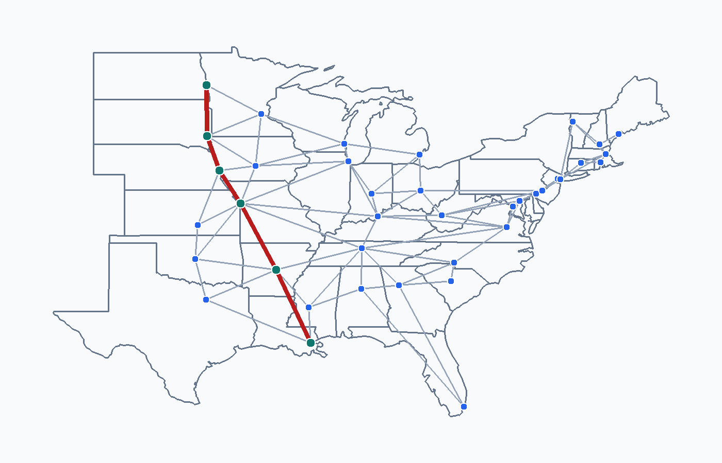
Route Comparison 2: Fargo → New Orleans
Travel Metrics
Route length: 6 cities
Path: Fargo → Sioux Falls → Omaha → Kansas City → ...
Map distance: 1464.1 miles
Travel days: 3 (max 8 hrs/day)
Total hours on road: 19.5 hrs
Gasoline consumed: 32.53 gal (45 mpg)
Best start date: 2026-01-16
Weather risk: 5.0 (1.00/leg avg)
Dijkstra shortest route: Fargo to New Orleans
PNW Spring 2026 CS 51510-002 Algorithms | Course Project 3

Slide 28
Route Comparison 3: Minneapolis → Houston
Travel Metrics
Route length: 0 cities
Path:
Map distance: 0.0 miles
Travel days: 1 (max 8 hrs/day)
Total hours on road: 0.0 hrs
Gasoline consumed: 0.0 gal (45 mpg)
Best start date: 2026-01-01
Weather risk: 0 (0.00/leg avg)
Dijkstra shortest route: Minneapolis to Houston
PNW Spring 2026 CS 51510-002 Algorithms | Course Project 3

Slide 29
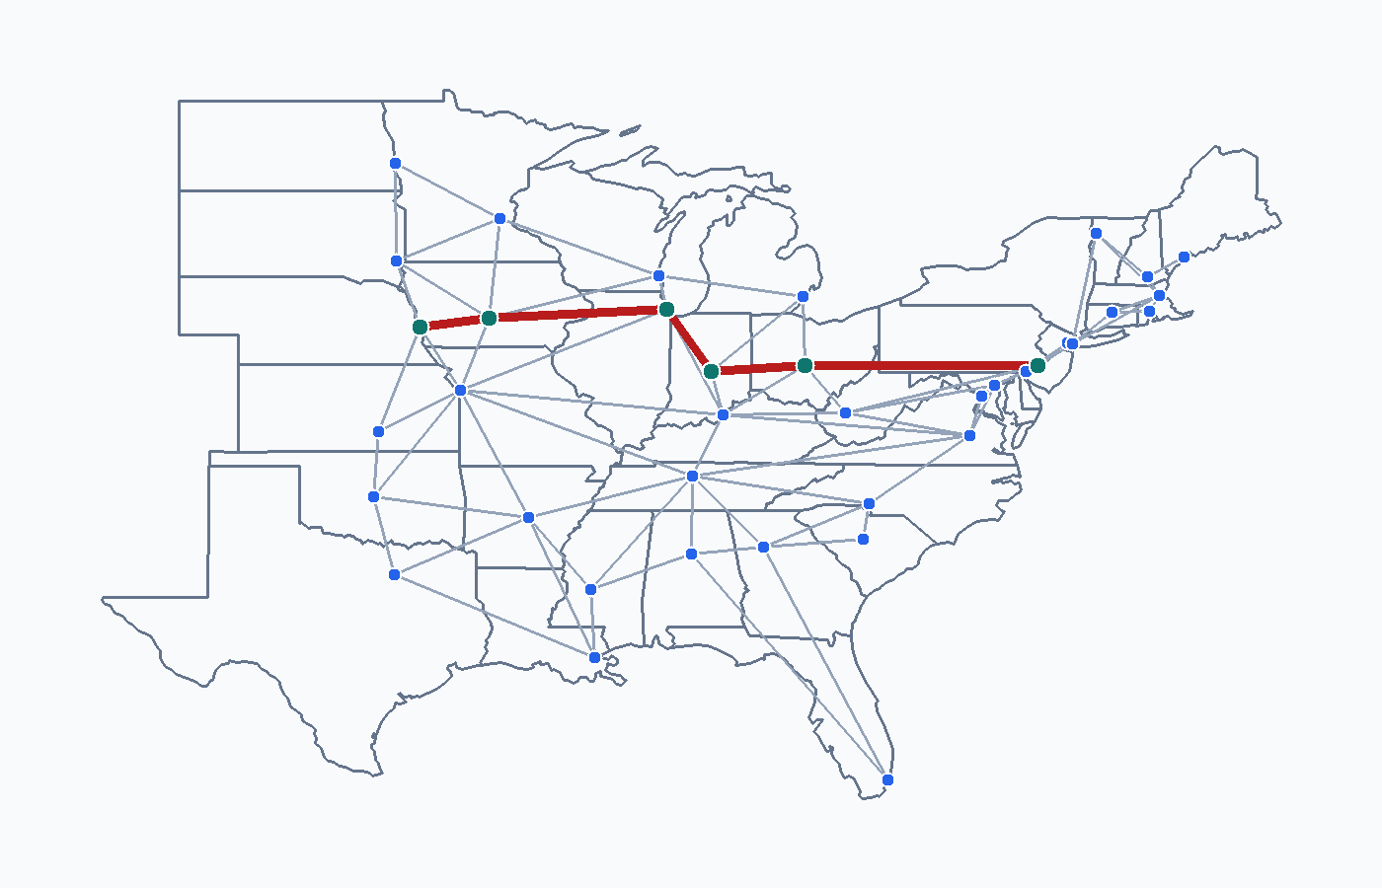
Route Comparison 4: Omaha → Philadelphia
Travel Metrics
Route length: 6 cities
Path: Omaha → Des Moines → Chicago → Indianapolis → ...
Map distance: 1391.4 miles
Travel days: 3 (max 8 hrs/day)
Total hours on road: 18.5 hrs
Gasoline consumed: 30.92 gal (45 mpg)
Best start date: 2026-02-08
Weather risk: 5.0 (1.00/leg avg)
Dijkstra shortest route: Omaha to Philadelphia
PNW Spring 2026 CS 51510-002 Algorithms | Course Project 3

Slide 30
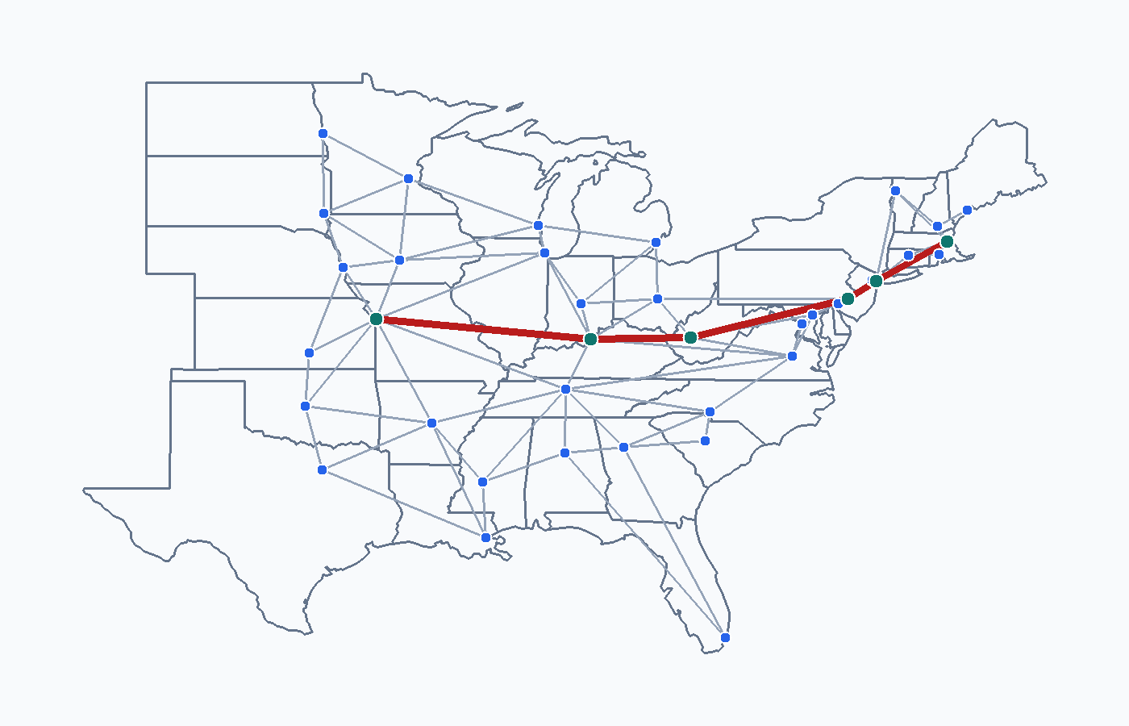
Route Comparison 5: Kansas City → Boston
Travel Metrics
Route length: 6 cities
Path: Kansas City → Louisville → Charleston → Philadelphia → ...
Map distance: 1578.1 miles
Travel days: 3 (max 8 hrs/day)
Total hours on road: 21.0 hrs
Gasoline consumed: 35.07 gal (45 mpg)
Best start date: 2026-03-04
Weather risk: 5.0 (1.00/leg avg)
Dijkstra shortest route: Kansas City to Boston
PNW Spring 2026 CS 51510-002 Algorithms | Course Project 3

Slide 31
Comparison 1: BFS vs DFS
Five cases compare traversal order and runtime from the same start city.
# Start City BFS ms DFS ms Same? First 5 BFS nodes
1 Chicago 0.098 0.092 True Chicago -> Milwaukee -> Indianapolis -> Louis
2 Dallas 0.061 0.083 True Dallas -> Oklahoma City -> Little Rock -> New
3 Boston 0.054 0.084 True Boston -> Providence -> Manchester -> Hartfor
4 Atlanta 0.054 0.079 True Atlanta -> Birmingham -> Columbia -> Nashvill
5 Minneapolis 0.053 0.080 True Minneapolis -> Sioux Falls -> Fargo -> Des Mo
✔ BFS and DFS visit the same connected component, but their visit orders differ.
✔ BFS explores level-by-level (breadth); DFS follows one branch deeply before backtracking.
PNW Spring 2026 CS 51510-002 Algorithms | Course Project 3

Slide 32
Comparison 2: Prim vs Kruskal
Five cases run Prim from different start cities and compare with Kruskal.
# Prim Start Prim ms Kruskal ms Prim mi Kruskal mi
1 Chicago 0.130 0.321 6429.2 6429.2
2 Dallas 0.086 0.275 6429.2 6429.2
3 Boston 0.082 0.262 6429.2 6429.2
4 Atlanta 0.080 0.253 6429.2 6429.2
5 Minneapolis 0.077 0.250 6429.2 6429.2
✔ Both Prim and Kruskal produce the same MST total mileage (6,429.2 mi), confirming correctness.
✔ Kruskal sorts all edges globally; Prim grows outward from a start city. Edge order may differ.
PNW Spring 2026 CS 51510-002 Algorithms | Course Project 3

Slide 33
Comparison 3: Dijkstra vs Bellman-Ford
Five route cases compare shortest-path distance, runtime, and travel metrics.
# Route Dij ms BF ms Same? Miles Days Gas gal Risk
1 Chicago to Miami 0.153 0.235 True 1469.8 3 32.66 4.0
2 Dallas to Boston 0.116 0.336 True 1924.2 4 42.76 11.0
3 Minneapolis to Atlanta 0.084 0.298 True 1202.0 3 26.71 5.0
4 New Orleans to New York 0.090 0.339 True 1520.8 3 33.80 12.0
5 Oklahoma City to Washington 0.127 0.389 True 1471.0 3 32.68 4.0
Detailed paths for each case:
Case 1: Chicago to Miami | Best date: 2026-01-09 | Avg risk: 1.0/leg
Dijkstra: Chicago -> Louisville -> Nashville -> Atlanta -> Miami
Bellman-Ford: Chicago -> Louisville -> Nashville -> Atlanta -> Miami
Case 2: Dallas to Boston | Best date: 2026-02-08 | Avg risk: 1.57/leg
Dijkstra: Dallas -> Little Rock -> Nashville -> Louisville -> Charleston -> Phil
Bellman-Ford: Dallas -> Little Rock -> Nashville -> Louisville -> Charleston -> Phil
Case 3: Minneapolis to Atlanta | Best date: 2026-01-09 | Avg risk: 1.0/leg
Dijkstra: Minneapolis -> Milwaukee -> Chicago -> Louisville -> Nashville -> Atla
Bellman-Ford: Minneapolis -> Milwaukee -> Chicago -> Louisville -> Nashville -> Atla
Case 4: New Orleans to New York | Best date: 2026-02-14 | Avg risk: 1.5/leg
Dijkstra: New Orleans -> Jackson -> Birmingham -> Atlanta -> Charlotte -> Richmo
Bellman-Ford: New Orleans -> Jackson -> Birmingham -> Atlanta -> Charlotte -> Richmo
Case 5: Oklahoma City to Washington | Best date: 2026-01-01 | Avg risk: 1.0/leg
Dijkstra: Oklahoma City -> Little Rock -> Nashville -> Richmond -> Washington
Bellman-Ford: Oklahoma City -> Little Rock -> Nashville -> Richmond -> Washington
PNW Spring 2026 CS 51510-002 Algorithms | Course Project 3

